Slide 1
CLASSES AND OBJECTS

Slide 2
INHERITANCE

Slide 3
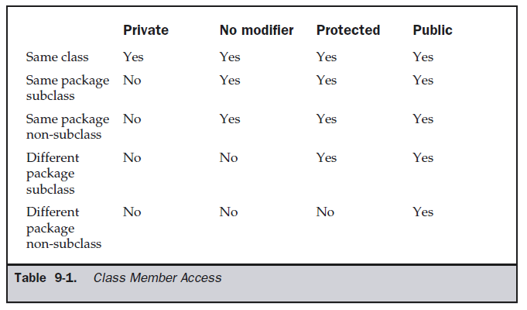
Access Protection

Slide 4
Inheritance
A subclass is a specialized version of a superclass.
A subclass inherits all the instance variables and methods from the superclass and adds its own unique elements.
Inheritance is facilitated in Java with the help of the keyword extends.

Slide 5
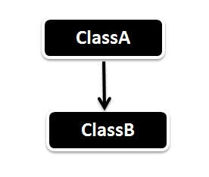
1 Single Inheritance
Super class subclass
Parent class child class
Based class derived class

Slide 6
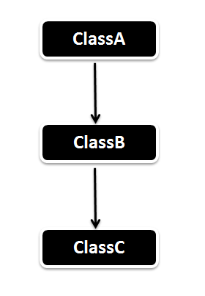
2 Multilevel Inheritance

Slide 7
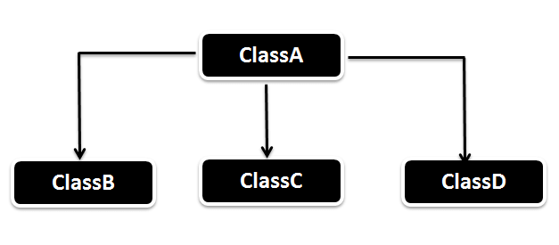
3 Hierarchical Inheritance

Slide 8
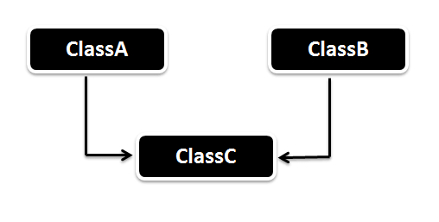
4 Multiple Inheritance
Not supported in java

Slide 9
class subclass-name extends superclass-name
{
// body of class
}

Slide 10
class A
{
}
class B extends A
{
}

Slide 11
class MyMessage1
{
void dispMessage1()
{
System.out.println(“Wel come”);
}
}
class MyMessage2 extends MyMessage1
{
void dispMessage2()
{
System.out.println(“MIT, Manipal”);
}
}
class SimpleInheritance
{ public static void main(String args[])
{
MyMessage2 m2 = new MyMessage2();
m2.dispMessage1();
m2.dispMessge2()
}
}

Slide 12
class A
{ int i, j;
void showij()
{ System.out.println("i and j: " + i + " " + j);
}
}
class B extends A
{ int k;
void showk()
{ System.out.println("k: " + k);
}
void sum()
{ System.out.println("i+j+k: " + (i+j+k));
}
}

Slide 13
class SimpleInheritance
{ public static void main(String args[])
{
B subOb = new B();
subOb.i = 7;
subOb.j = 8;
subOb.k = 9;
System.out.println("Contents of subOb: ");
subOb.showij();
subOb.showk();
subOb.sum();
}
}

Slide 14
Member Access and Inheritance
derived cannot access members of the superclass that have been declared as private.

Slide 15
/* private members remain private to their class */
class A
{ int i;
private int j; // private to A
void setij(int x, int y)
{ i = x;
j = y;
}
}
class B extends A
{ int total;
void sum()
{ total = i + j; // ERROR, j is not accessible here
}
}

Slide 16
//This program uses inheritance to extend Box.
class Box {
double width;
double height;
double depth;
Box(Box ob) // construct clone of an object
{ width = ob.width;
height = ob.height;
depth = ob.depth;
}
Box(double w, double h, double d)
{ width = w;
height = h;
depth = d;
}

Slide 17
Box()
{ width = -1; // use -1 to indicate
height = -1; // an uninitialized
depth = -1; // box
}
// constructor used when cube is created
Box(double len)
{ width = height = depth = len;
}
double volume()
{ return width * height * depth;
}
}

Slide 18
class BoxWeight extends Box
{ double weight;
BoxWeight(double w, double h, double d, double m)
{ width = w;
height = h;
depth = d;
weight = m;
}
}

Slide 19
class DemoBoxWeight
{ public static void main(String args[])
{
BoxWeight mybox1 = new BoxWeight(10, 20, 15, 34.3);
BoxWeight mybox2 = new BoxWeight(2, 3, 4, 0.076);
double vol;
vol = mybox1.volume();
System.out.println("Volume of mybox1 is " + vol);
System.out.println(“Weight of mybox1 is " + mybox1.weight);
System.out.println();
vol = mybox2.volume();
System.out.println("Volume of mybox2 is " + vol);
System.out.println(“Weight of mybox2 is " + mybox2.weight);
} }

Slide 20
//Box is extended to include color
class ColorBox extends Box
{
int color; //color of Box
ColorBox(double w, double h, double d, int c)
{ width = w;
height = h;
depth = d;
color = c;
}
}

Slide 21
A superclass variable can reference a subclass object
The type of the reference variable (not the type of the object) determines what members can
be accessed.
when a reference to a subclass object is assigned to a superclass reference variable, we will
have access to only those parts of the object defined by the superclass.

Slide 22
A superclass variable can reference a subclass object
BoxWeight weightbox = new BoxWeight(3, 5, 7, 8.37);
Box plainbox = new Box();
double vol;
plainbox = weightbox;
vol = plainbox.volume();
System.out.println("Volume of plainbox is " + vol);
//following is invaild because plainbox does not define a weight member.
//System.out.println(“Weight of plainbox is " + plainbox.weight);

Slide 23
In the previous example,
weightbox is a reference to BoxWeight objects and plainbox is a reference to Box objects. Since BoxWeight is a subclass of Box, it is permissible to assign plainbox a reference to the weightbox object.
The type of the reference variable (not the type of the object) determines what members can be accessed.
ie, when a reference to a subclass object is assigned to a superclass reference variable, we will have access to only those parts of the object defined by the superclass.
Hence plainbox can’t access weight even when it refers to a BoxWeight object.

Slide 24
When Constructors Are Called
class A
{ A()
{ System.out.println("Inside A's constructor.");
}
}
// Create a subclass by extending class A.
class B extends A
{ B()
{ System.out.println("Inside B's constructor.");
}
}
class C extends B
{ C()
{ System.out.println("Inside C's constructor.");
}
}

Slide 25
class CallingCons
{
public static void main(String args[])
{
C c = new C();
}
}

Slide 26
The output from this program is shown here:
Inside A’s constructor
Inside B’s constructor
Inside C’s constructor

Slide 27
  METHOD OVERRIDING

Slide 28
// Method overriding.
class A
{
int i, j;
A(int a, int b)
{
i = a;
j = b;
}
// display i and j
void show()
{
System.out.println("i and j: " + i + " " + j);
}
}

Slide 29
class B extends A
{ int k;
B(int a, int b, int c)
{ super(a, b);
k = c;
}
// display k – this overrides show() in A
void show()
{
System.out.println("k: " + k);
}
}
class Override
{
public static void main(String args[])
{
B subOb = new B(1, 2, 3);
subOb.show(); // this calls show() in B
}
}

Slide 30
Using super
When a subclass needs to refer to its immediate superclass, it can do so by use
of the keyword super.
super has two general forms.
To call the superclass’ constructor.
To access a member of the superclass that has been hidden by a member of a subclass.

Slide 31
Using super to Call Superclass Constructors
A subclass can call a constructor method defined by its superclass by use of the
following form of super:
super(parameter-list);
Here, parameter-list specifies any parameters needed by the constructor in the
superclass.
super( ) must always be the first statement executed inside a subclass’ constructor.

Slide 32
// BoxWeight now uses super to initialize its Box attributes.
class BoxWeight extends Box
{
double weight; // weight of box
// initialize width, height, and depth using super()
BoxWeight(double w, double h, double d, double m)
{
super(w, h, d); // call superclass constructor
weight = m;
}
}
BoxWeight(double w, double h, double d, double m)
{
width = w;
height = h;
depth = d;
weight = m;
}

Slide 33
A Second Use for super
The second is used to access a member of the superclass that has been hidden by a
member of a subclass.
This usage has the following general form:
super.member
Here, member can be either a method or an instance variable.
applicable to situations in which member names of a subclass hide members by the same name in the superclass.

Slide 34
class A
{ int i;
}
class B extends A
{
int i; // this i hides the i in A
B(int a, int b)
{ super.i = a; // i in A
i = b; // i in B }
void show()
{ System.out.println("i in superclass: " + super.i);
System.out.println("i in subclass: " + i); }
}

Slide 35
class UseSuper
{
public static void main(String args[])
{
B subOb = new B(1, 2);
subOb.show();
}
}

Slide 36
Accessing superclass version of an overridden method using super
If we wish to access the superclass version of an overridden function, we can do This by using super.

Slide 37
class A
{ int i, j;
A(int a, int b)
{ i = a;
j = b; }
void show()
{ System.out.println("i and j: " + i + " " + j); }
}
class B extends A
{ int k;
B(int a, int b, int c)
{ super(a, b);
k = c;
}
void show()
{ super.show(); // this calls A's show()
System.out.println("k: " + k); } }

Slide 38
Method overriding occurs only when the names and the type signatures of the two methods are
identical. If they are not, then the two methods are simply overloaded.

Slide 39
// Methods with differing type signatures are overloaded – not overridden.
class A
{ int i, j;
A(int a, int b)
{ i = a;
j = b; }
void show()
{ System.out.println("i and j: " + i + " " + j); }
}
class B extends A
{ int k;
B(int a, int b, int c)
{ super(a, b);
k = c; }
void show(String msg)
{ System.out.println(msg + k); }
}

Slide 40
class Override
{
public static void main(String args[])
{
B subOb = new B(1, 2, 3);
subOb.show("This is k: "); // this calls show() in B
subOb.show(); // this calls show() in A
}
}

